Slide 1
Welcome

Slide 2
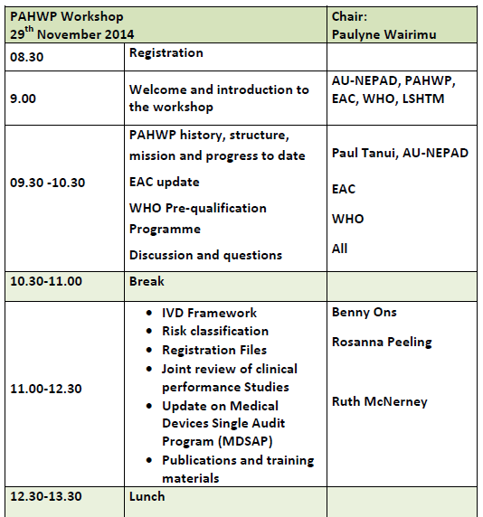

Slide 3
